Slide 1
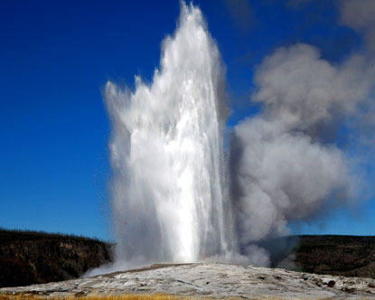
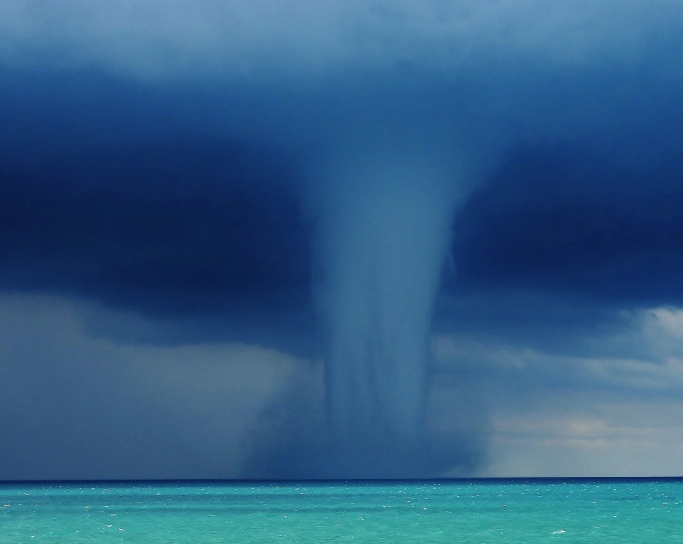
Terrestrial Examples of Pressurization and Evacuation
Pressure Drop From Above
Pressure Rise From below

